Slide 1

Capstone Project
SEOUL BIKE SHARING DEMAND PREDICTION

Slide 2
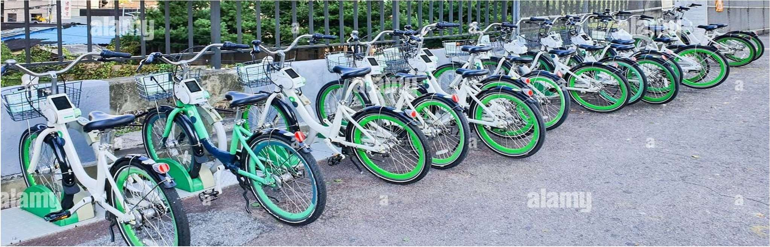

PROBLEM DESCRIPTION:
Currently Rental bikes are introduced in many urban cities for the enhancement of mobility comfort. It is important to make the rental bike available and accessible to the public at the right time as it lessens the waiting time. Eventually, providing the city with a stable supply of rental bikes becomes a major concern. The crucial part is the prediction of bike count required at each hour for the stable supply of rental bikes.

Slide 3
CONTENT
BUSINESS UNDERSTANDING
DATA SUMMARY
FEATURE ANALYSIS
EXPLORATORY DATA ANALYSIS
DATA PREPROCESSING
IMPLEMENTING ALGORITHMS
CONCLUSION

Slide 4
BUSINESS UNDERSTANDING
Bike rentals have became a popular service in recent years and it seems people are using it more often. With relatively cheaper rates and ease of pick up and drop at own convenience is what making this business thrive.
Mostly used by people having no personal vehicles and also to avoid congested public transport which that’s why they prefer rental bikes.
Therefore, the business to strive and profit more, it has to be always ready and supply no. of bikes at different locations, to fulfil the demand.
Our project goal is a pre planned set of bike count values that can be a handy solution to meet all demands.

Slide 5
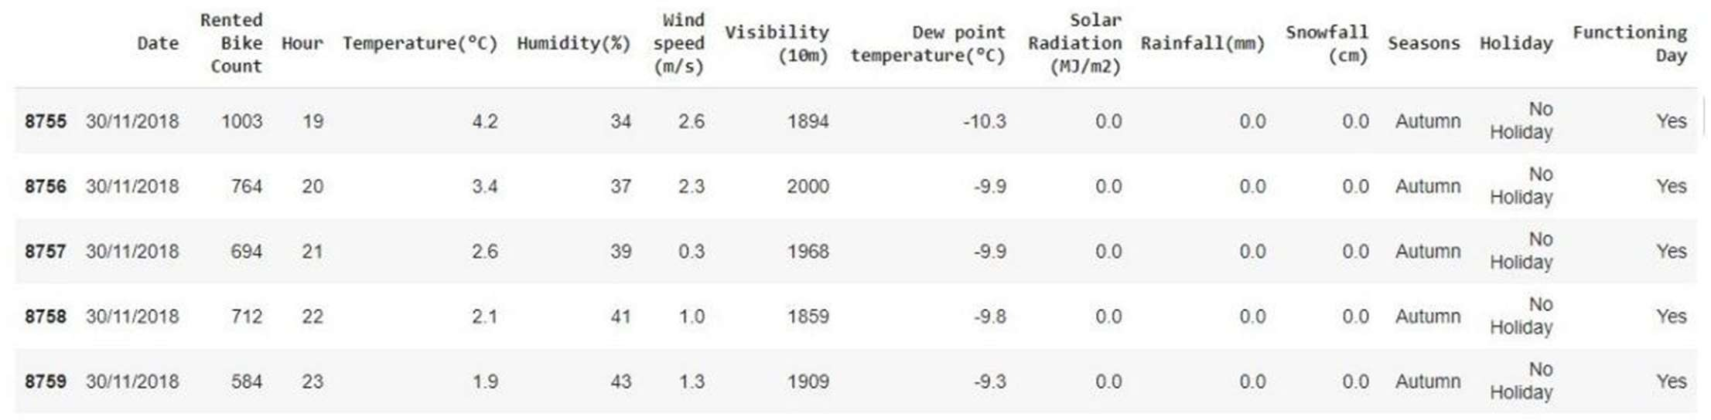
DATA SUMMARY
This Dataset contains 8760 record and 14 columns.
Three categorical features ‘Seasons’, ‘Holiday’, & ‘Functioning Day’.
One Datetime features ‘Date’.
We have some numerical type variables such as temperature, humidity, wind, visibility, dew point temp, solar radiation, rainfall, snowfall which tells the environment conditions at that particular hour of the day.

Slide 6
FEATURE SUMMARY
Date : Year-Month-Day
Rented Bike Count - Count of bikes rented at each hour
Hour - Hour of the day
Temperature - Temperature in Celsius
Humidity - %
Wind Speed - m/s
Visibility - 10m
Dew point temperature -Celsius
Solar radiation -MJ/m2
Rainfall -mm
Snowfall –cm
Seasons -Winter, Spring, Summer, Autumn
Holiday -Holiday/No Holiday
Functional Day - NoFunc(Non Functional Hrs),Fun(Functional Hrs)

Slide 7
INSIGHTS FORM THE
DATASETS
There are No Missing Values present
There are No Duplicate values present
There are No null values.
And finally we have dependent feature 'rented bike count' variable which we need to predict for new observations .
The dataset shows hourly rental data for one year (1 December 2017 to 31 November(2018)(365 days).we consider this as a single year data

Slide 8
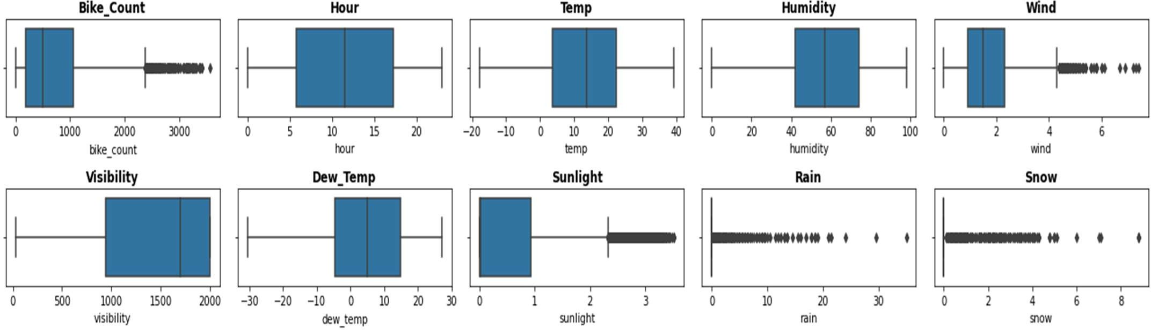
COLUMNS WISE ANALYSIS
1.From above graphs we detect ,Outliers are present in the bike_count, wind,sunlight,rain,snow.
2.Dependent variable i.e bike_count having a moderate right skewed, to apply linear regression dependent feature have to follow the normal distribution .Therefore we use IQR and log transformation.
3.Features like wind , sunlight,rain,snow are to be treated by IQR method, where we capped the record after 99 percentile with the median Value of that column .

Slide 9
MANIPULATING THE DATASETS
Added new feature called weekend which takes Saturday and Sunday as one else zero
.
Added one more new feature called day_or_night which is followed by two segment named as Day, Night.
Dropping the date column after taking out month_name, and day_name.
Defining a label encoder of three different columns Holiday , functioning day and day_or_night .
a.In holiday column it takes holiday as one and no holiday as zero .
b.From functioning day column takes one as functioning day and zero as no functioning happen.
c.Lastly from the day_or_night column which takes night equal to 0, day equal to 1 .
Doing one hot encoding of feature seasons and month_name
We come up with 28 features. By applying RFE we select top 13 feature contributing towards prediction

Slide 10
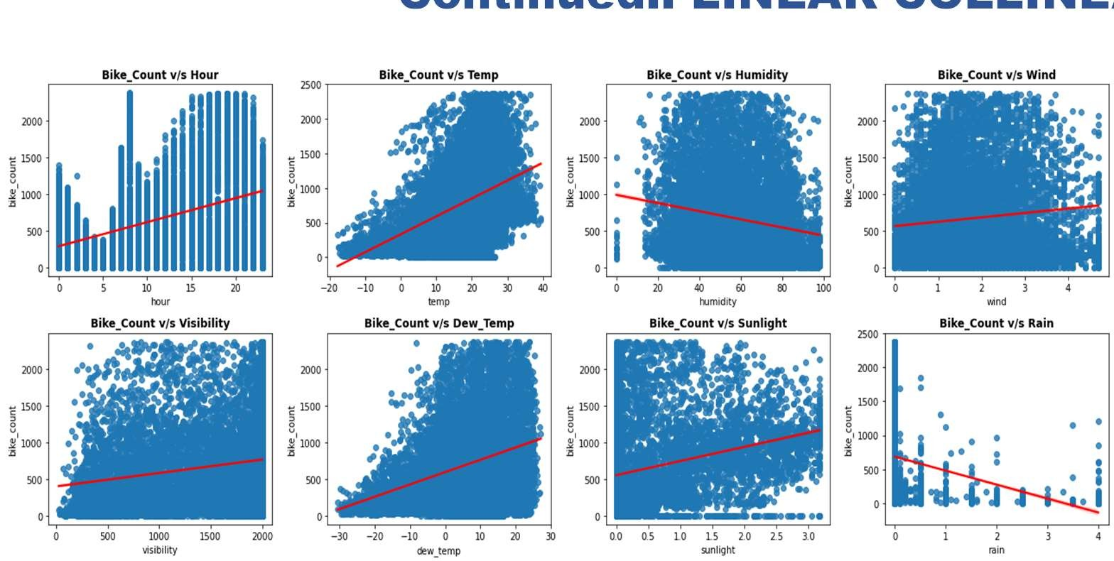
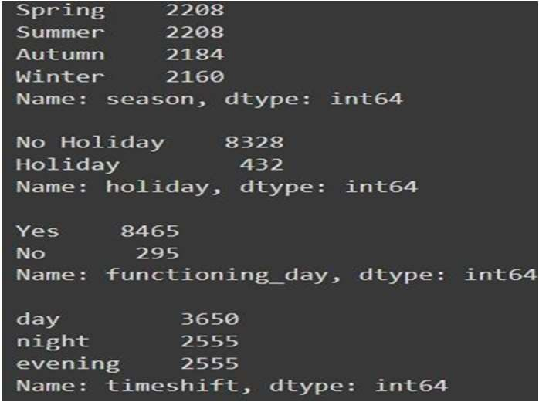
Continued.. LINEAR COLLINEARITY
Using one hot encoding in the season column to create the dummies feature of column segment like summer , autumn, spring and winter.
Adding a new variable called independent_variable contains all column except bike_count.
Adding some value counts of the categorical column : Autumn has max count in the season col, followed by no holiday , yes in the functioning day , and day segment in the timeshift column.

Slide 11
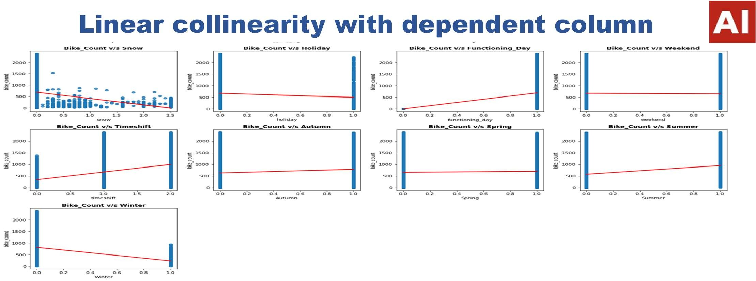
Linear collinearity with dependent column
From the previous slide graphs hour column is positively correlated with the bike_count , sudden increase in the dataset after 5.
temp, sunlight , dew_temp are also positively co-related with the bike_count , increasing in the count as raise in the x –axis observation.
Humidity , rain, snow, winter column having a negative correaltion between the bike_count
, rest of it having moderate match up b/w the count.

Slide 12
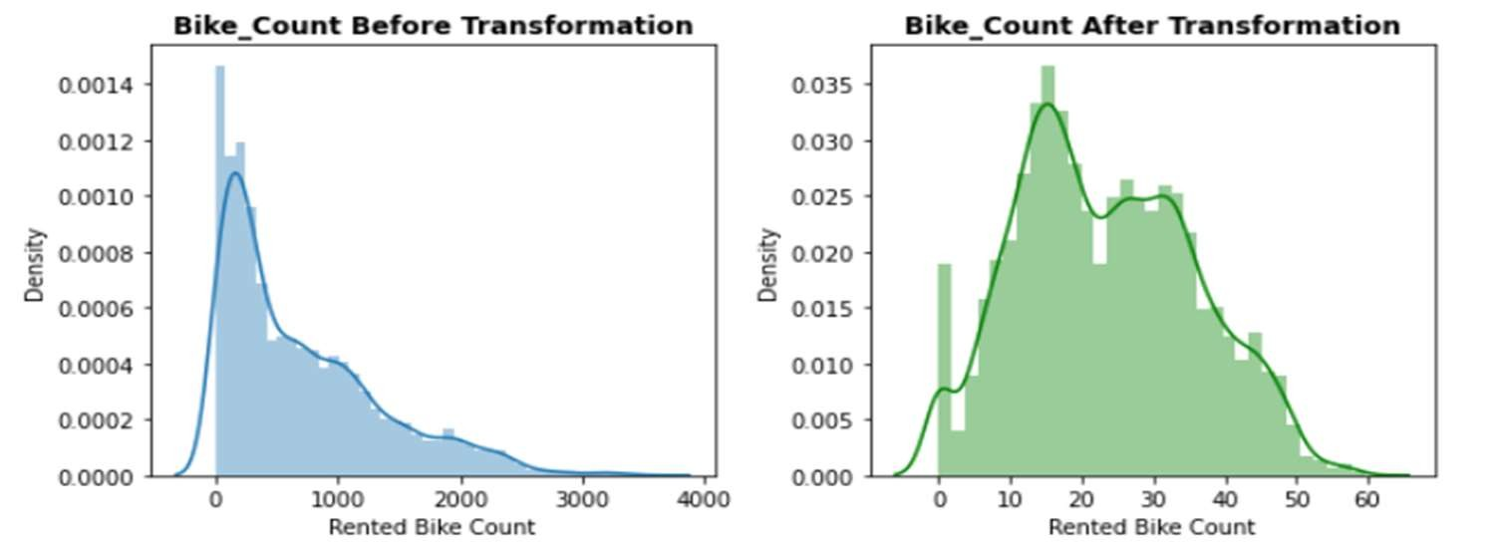
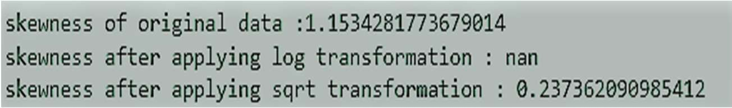
DEPENDENT VARIABLE (bike_count)
From the original records of the bike_count having high skew value 0.98 which is approaching towards the right , to apply model ,we need to transform our dependent feature to look like a normal distribution.
After applying square root transformation skewness value = 0.15, there is no outlier present in the records , distribution looks like a normal one .

Slide 13
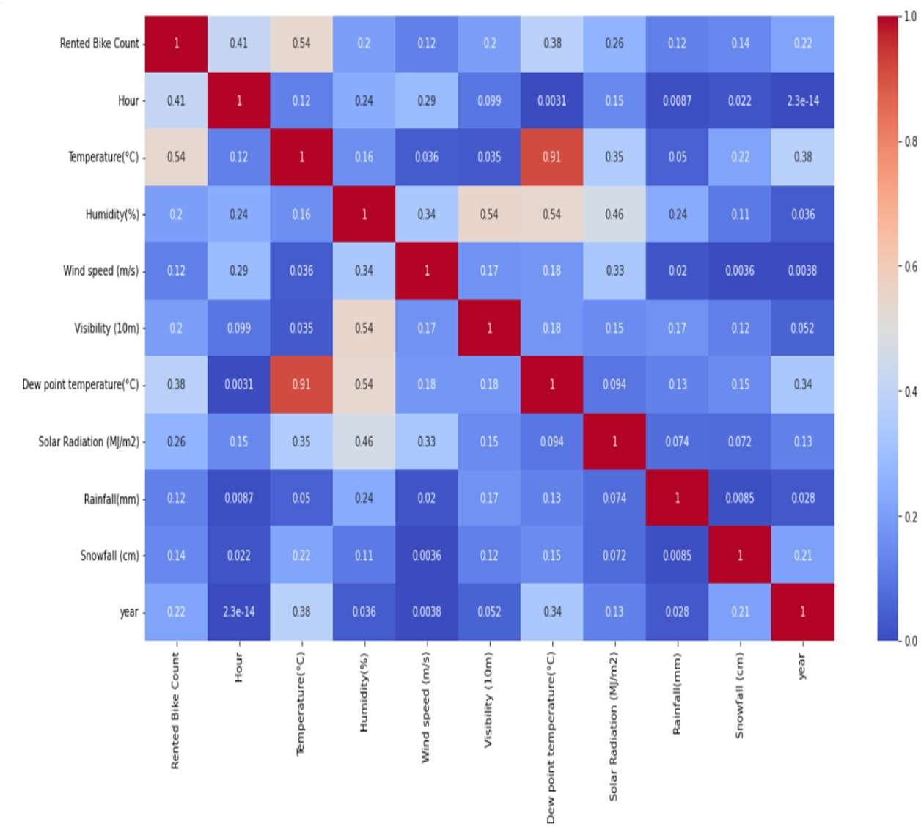
MULTICOLLINEARITY
Multicollinearity allows us to look at correlations (that is, how one variable changes with respect to another).
In words, the statistical technique that examines the relationship and explains whether, and how strongly, pairs of variables are related to one another is known as correlation.
Dew_temp and temp are highly correlated .
humidity and visibility are also having much relation between them.
We can see one highly correlated feature. Lets treat it by excluding it from dataset and checking the variance inflation factors.

Slide 14
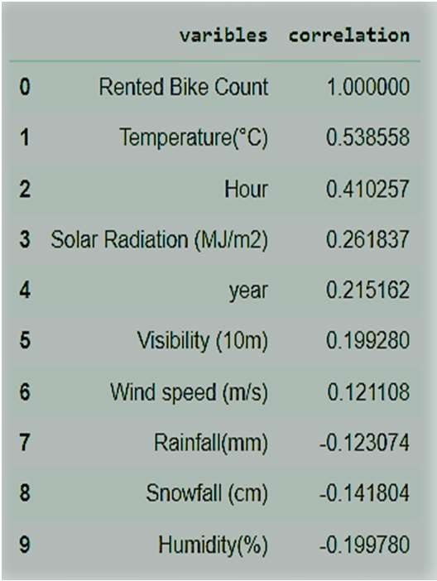
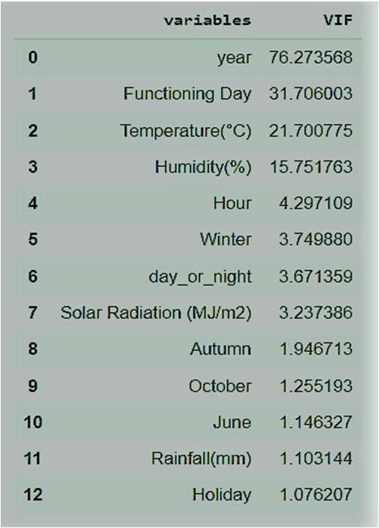
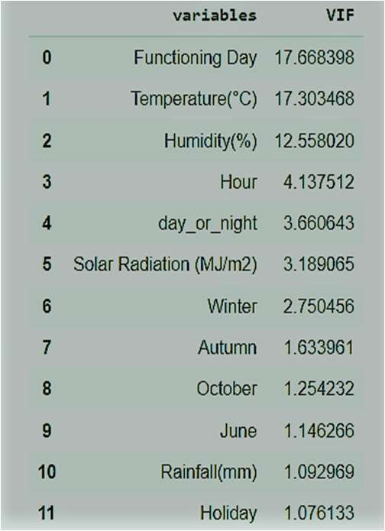
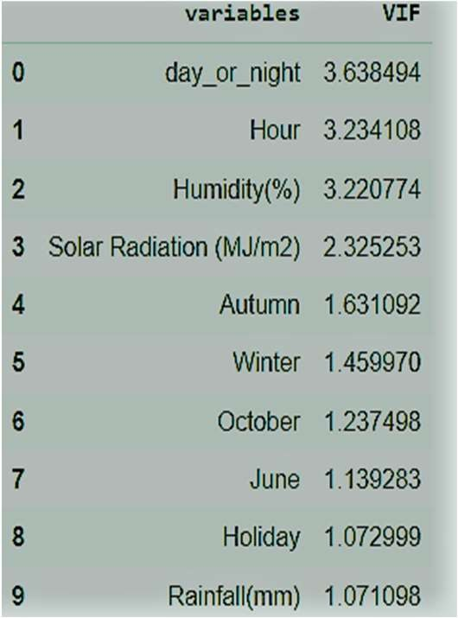
REMOVING MULTICOLLINEARITY
VIF determines the strength of the correlation between the independent variables. It is predicted by taking a variable and regressing it against every other variable. VIF score of an independent variable represents how well the variable is explained by other independent variables.
Since Summer and Winter can also be classified on the basis of temperature and we already have that feature present. Even if we drop these features the useful information will not be lost. So lets drop them.
Taking less than VIF of nine for the best input we can give to the model.

Slide 15
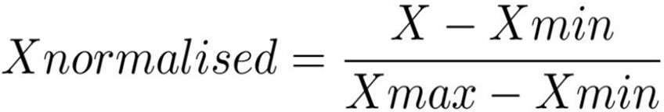
MODEL BUILDING
Prerequisites
Feature Scaling or Standardization: It is a step of Data Pre Processing which is applied to independent variables or features of data. It basically helps to normalise the data within a particular range. Sometimes, it also helps in speeding up the calculations in an algorithm.
Here we used MinMax scaler :Normalisation scales our features to a predefined range (normally the 0–1 range), independently of the statistical distribution they follow. It does this using the minimum and maximum
values of each feature in our data set, which makes it a bit sensitive to outliers.

Slide 16
MODEL BUILDING
Prerequisites
Defining a new function called analyse_model which takes
model, X_train, X_test, y_train, y_test tends to give the value of the evaluation matrix like MSE,RMSE,MAE,TARIN R2 ,TEST R2 , ADJUSTED R2.Continuing to that it also be liable to print the feature importance of the algorithm used.
In linear regression we used to print the feature importance with the help of beta coefficient which be prone ot give the exact feature importance used case like other algorithm.
range of values for hyperparameters such as Number of trees: n_estimators=[100,120]
Maximum depth of trees: [1-20]
Minimum number of samples required to split a node:min_samples_split=[50,100,1 50]
Minimum number of samples required at each leaf node:min_sample_leaf=[40,50]
learning rate : Eta=[0.3,0.2,0.1]

Slide 17
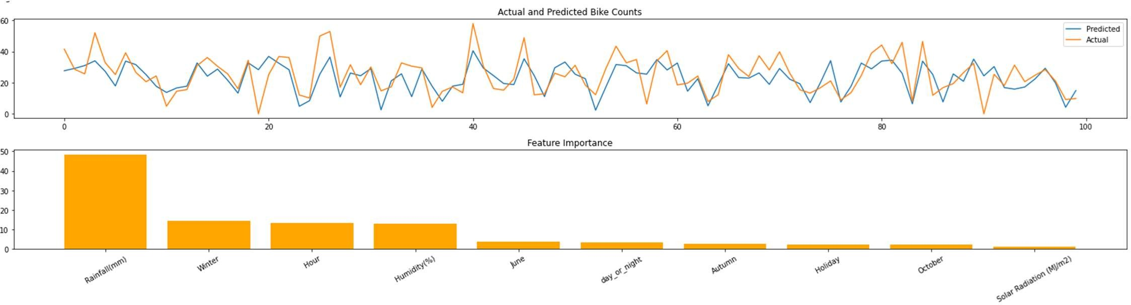
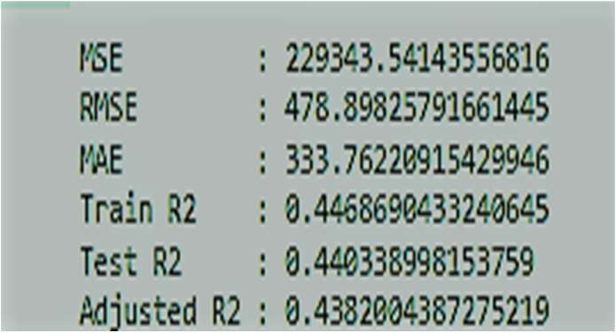
LINEAR REGRESSION
Linear Regression Supervised machine learning models are those where we use the training data to build the model and then test the accuracy of the model using the loss function.
Here we can accommodate linear regression model is unable to capture the evaluation matrix.
rainfall is best coefficient which is mostly responsible for the model performance.

Slide 18
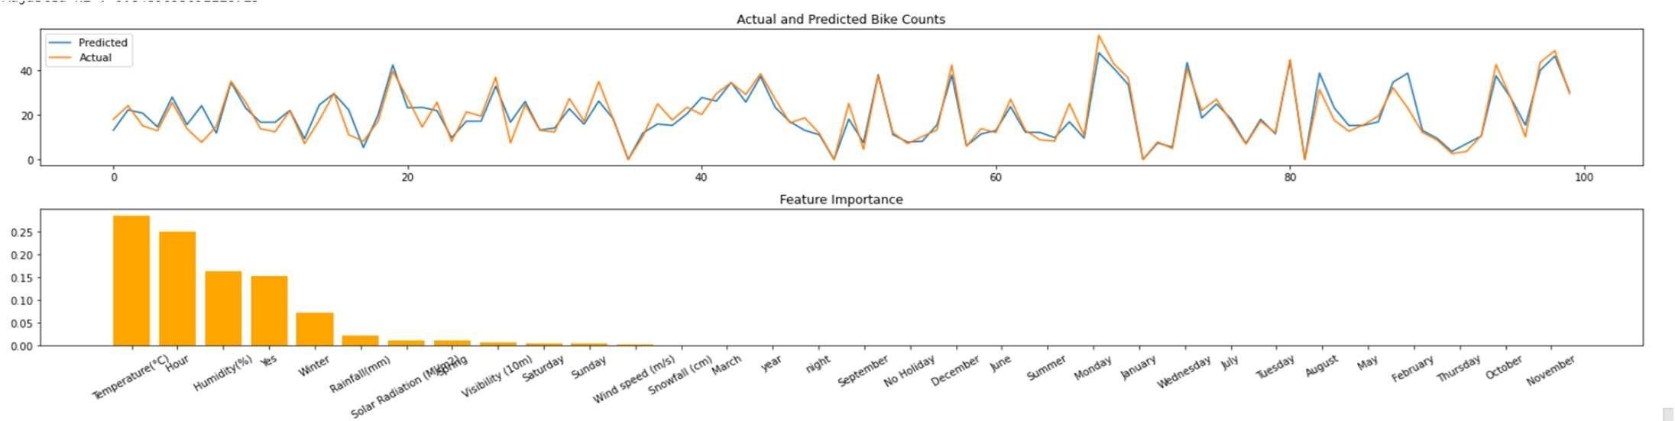
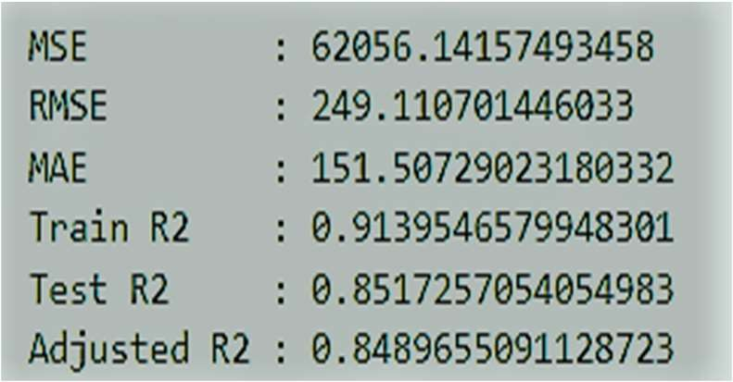
DECISION TREE
Decision trees classify instances by sorting them down the tree from the root to some leaf node, which provides the classification of the instance.
Decision tree performs well better than the linear reg with a test r2 score more than 75%.
Temp attended to be the best feature_importance for the model performance .
DecisionTreeRegressor(max_depth=14, min_samples_leaf=8, random_state=0)

Slide 19
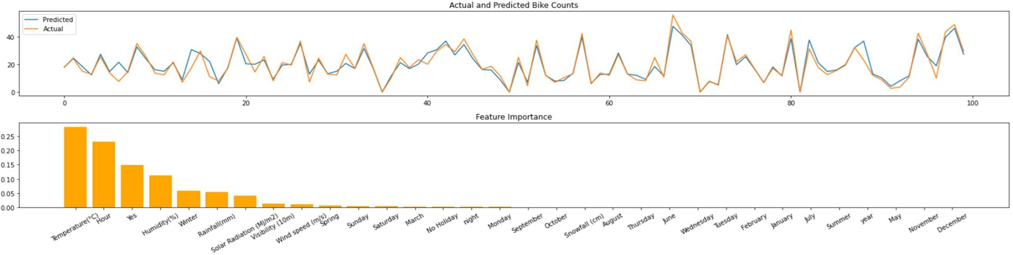
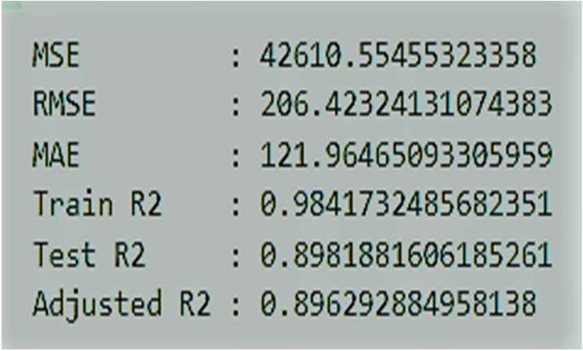
RANDOM FOREST REGRESSOR
Random Forest is a bagging type of Decision Tree Algorithm that creates a number of decision trees from a randomly selected subset of the training set.
Random forest also performs well in both test and train data with a r2 score of train 98% and in test r2 score with 89% .
Talking in terms of the feature importance , temp emerges as the contributor and is also became the highly important for the model performance.
RandomForestRegressor(max_depth=19, n_estimators =100)

Slide 20
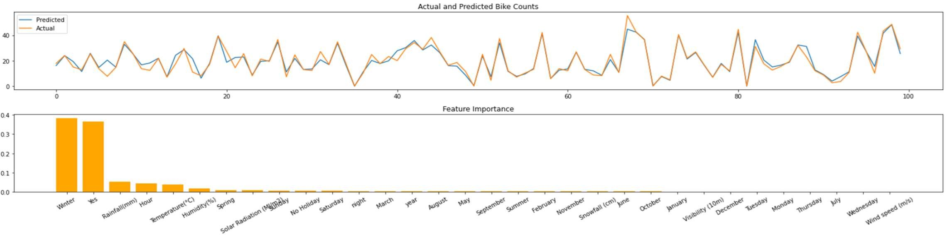
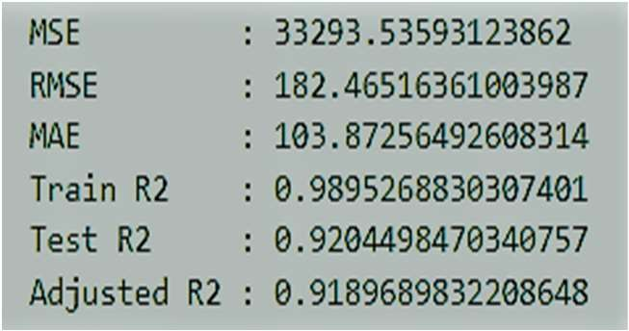
XGBOOST REGRESSOR
The objective function contains loss function and a regularization term. It tells about the difference between actual values and predicted values, i.e how far the model results are from the real values.
XGBoost regressor emerges as the best model according to the evaluation matrix score both in the train and test ,winter becomes as the best feature and is responsible for the model performance.
XGBRegressor(eta=0.3, max_depth=9, n_estimators=120)

Slide 21
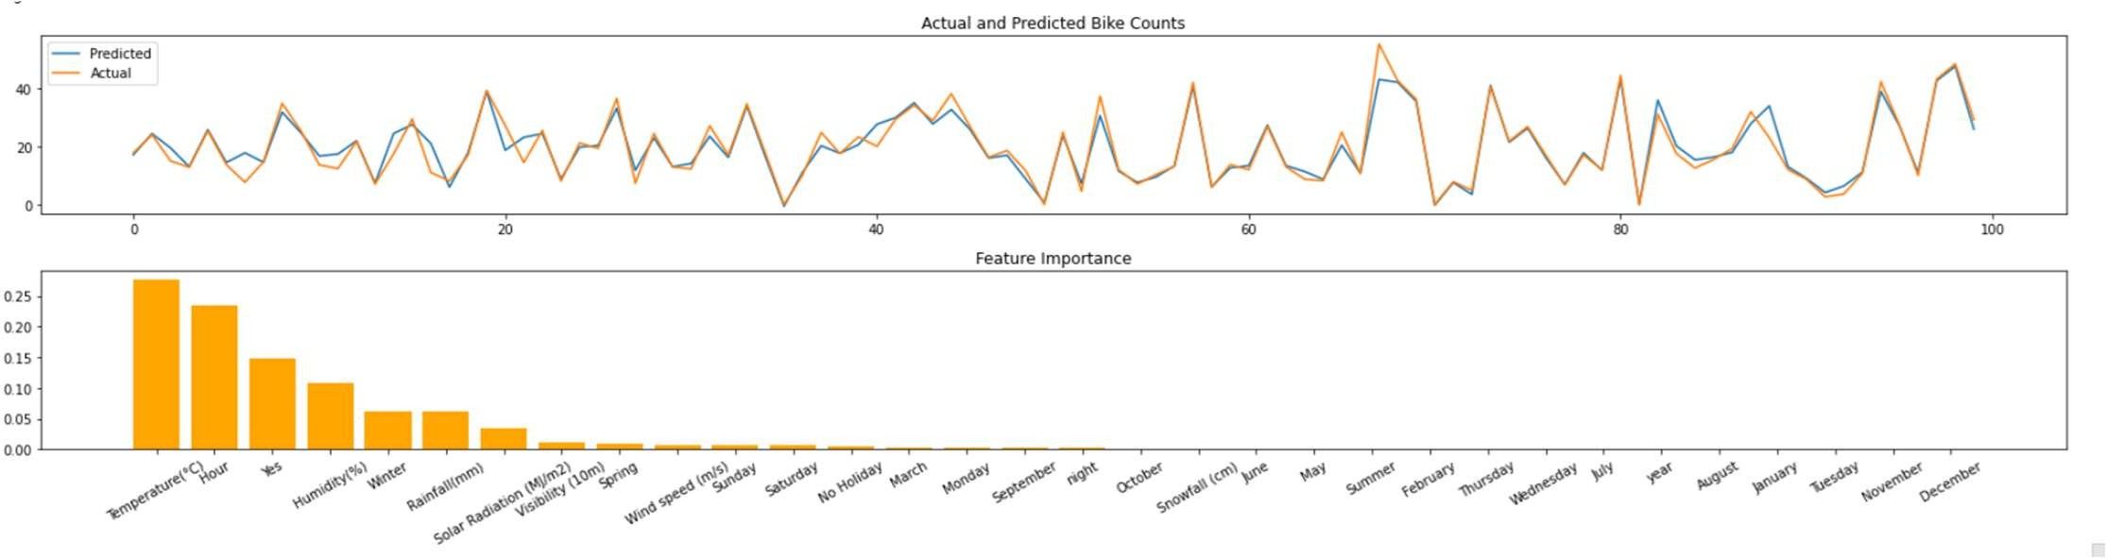
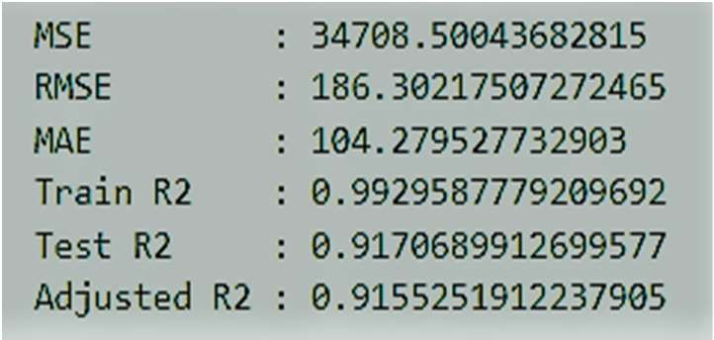
GRADIENT BOOSTING REGRESSOR
Gradient boosting re-defines boosting as a numerical optimisation problem where the objective is to minimise the loss function of the model by adding weak learners using gradient descent.
Here temperature became the best feature which responsible for the model performance.
GradientBoostingRegressor(max_depth=9, n_estimators=120)

Slide 22
CONCLUSION
Rainfall is the most influencing feature and winter is at the second place for Linear Regressor.
Temperature is the most important feature and Hour is at second place for Decision Tree, Random Forest and Gradient Boosting Regressor.
Winter is the most important feature and Functioning day[yes] is the second most for XGBoost Regressor.
RMSE Comparisons:
Linear Regressor RMSE: 478.89
Decision Tree Regressor RMSE: 249.11
Random Forest Regressor RMSE: 207.06
XGBoost Regressor RMSE: 184.27
Gradient Boosting Regressor RMSE: 186.55
The feature temperature is on the top list for all the regressors except XGBoost and Linear Regessor.
XGBoost and Linear Regressor is acting different from all the regressors as it is considering whether it is winter or not. And is it a working day or not. Though winter is also a function of temperature only but it seems this trick of XGBoost is giving better results.
XGBoost Regressor has the Least Root Mean Squared Error. but also, GradientBoostingRegressor is very close to XGBoost, since both are the boosting algorithm. So, any one of them can be considered as the best model for given problem.

